Slide 1










BANKING RISK ANALYTICS DASHBOARD USING POWER BI
Power BI | DAX | Banking Insights
Project Overview:
Interactive Banking Analytics Solution for:
💰 Loan analysis
🏦 Deposit Analysis
📊 Banking KPI Tracking
🛡️Risk Insights
Tools & Technologies:
Data Analytics Project | 2026
Presented by:
Divyaa Shri B

Slide 2

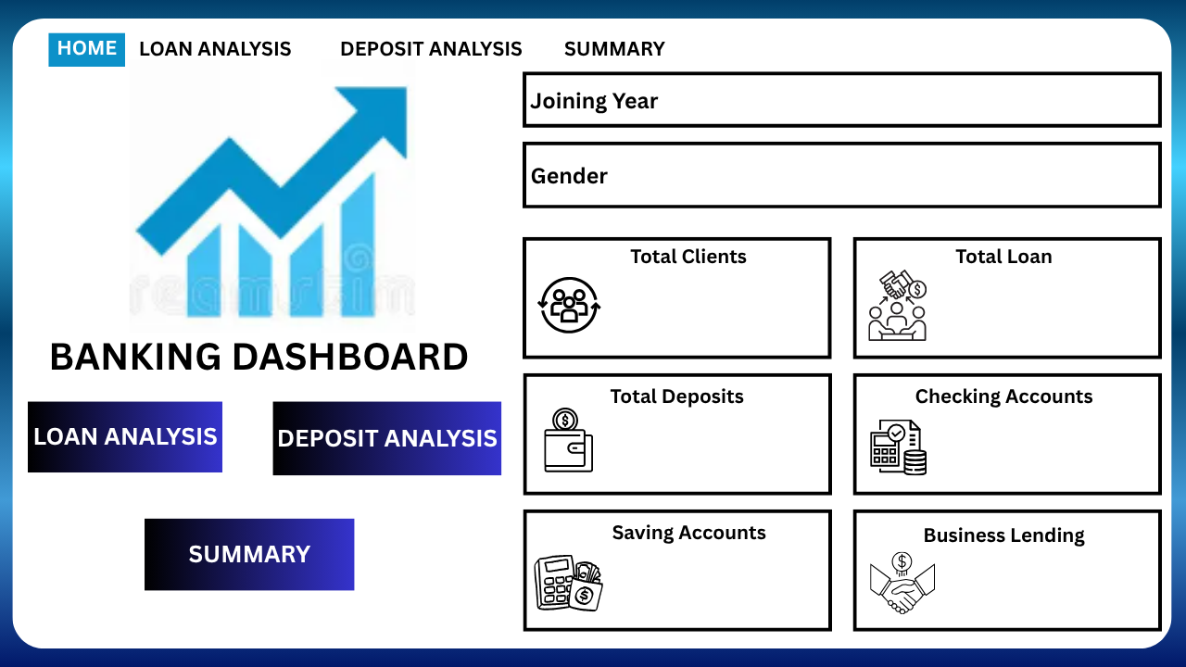

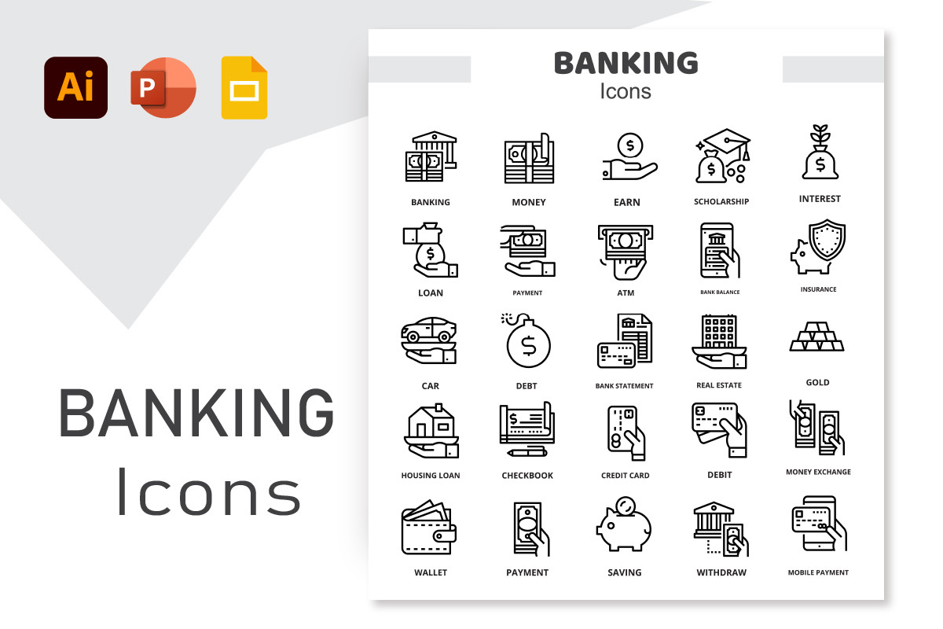


Project Overview
Objective
✔️ This project focuses on analyzing banking customer data to monitor loans, deposits, customer relationships, and banking KPIs through an interactive Power BI dashboard.
✔️ The dashboard helps identify business trends, customer behavior patterns, and banking performance insights for better decision-making.
Business Problem Statement
📌 Banks manage large volumes of customer financial data daily. Analyzing loans, deposits, customer segmentation, and banking relationships manually becomes difficult and time-consuming.
Key Goals of the Dashboard
📊 Analyse customer loan distribution
🏧 Monitor total deposits and account types
📇 Track banking relationship categories
🧩 Identify customer income patterns
📈 Generate business insights using interactive visuals

Slide 3

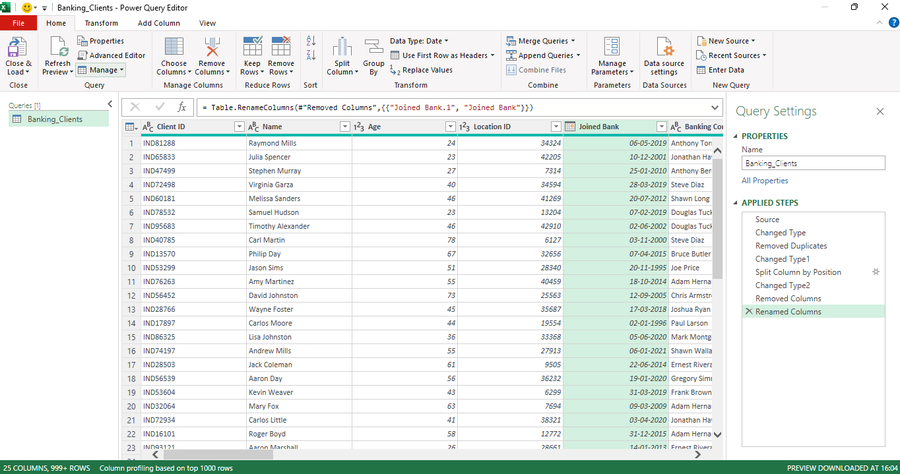
Dataset & Data Preparation
Dataset Overview
The dataset contains banking customer information related to:
Customer demographics
Loan details
Deposit information
Banking relationship types
Income categories
Account balances
This data is used to analyze banking performance and customer financial behavior.
Data Preparation Process
The raw dataset was cleaned and transformed using Power Query before visualization.
Data Cleaning Steps Performed
✔️ Removed null and duplicate values
✔️ Standardized column names
✔️ Corrected inconsistent categories
✔️ Formatted numeric and currency fields
✔️ Created calculated columns for analysis
✔️ Validated banking KPI values

Slide 4
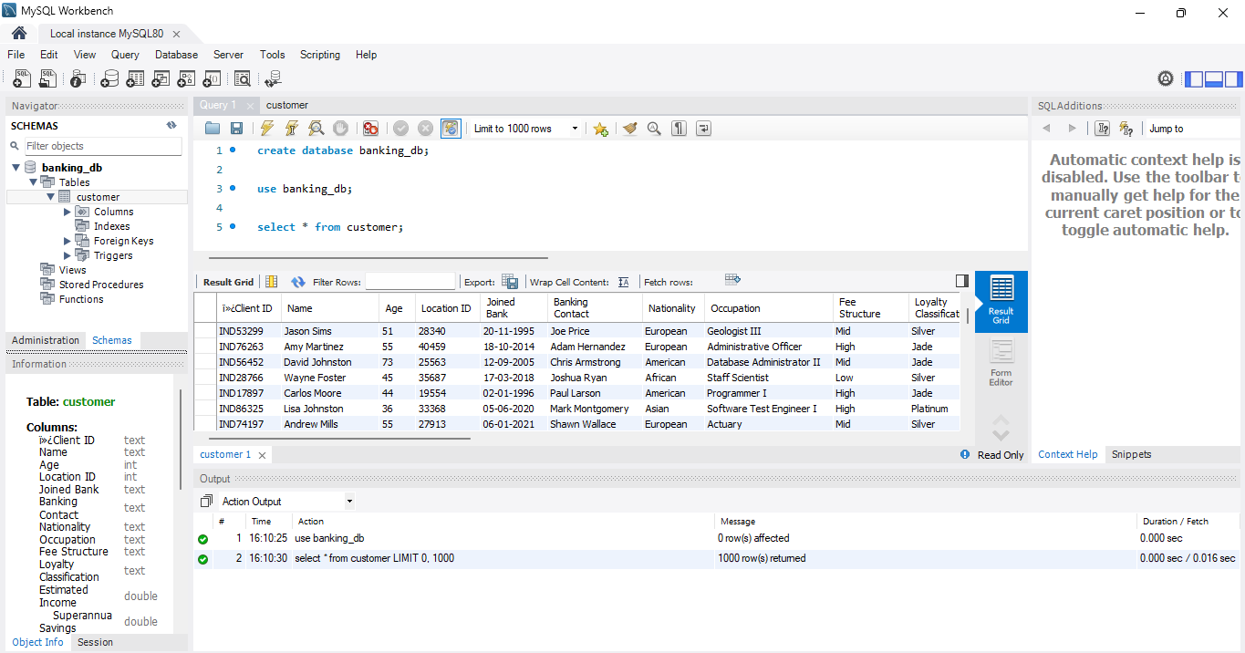
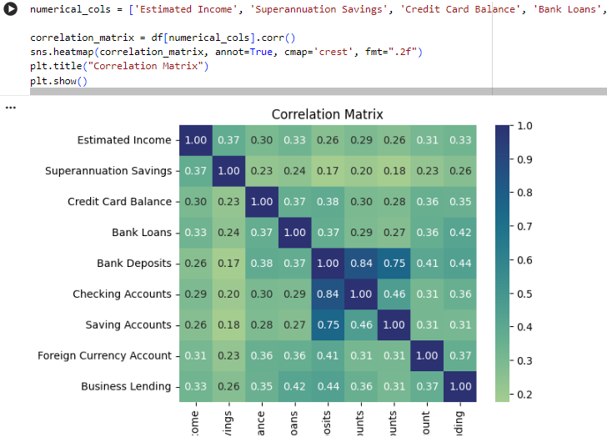
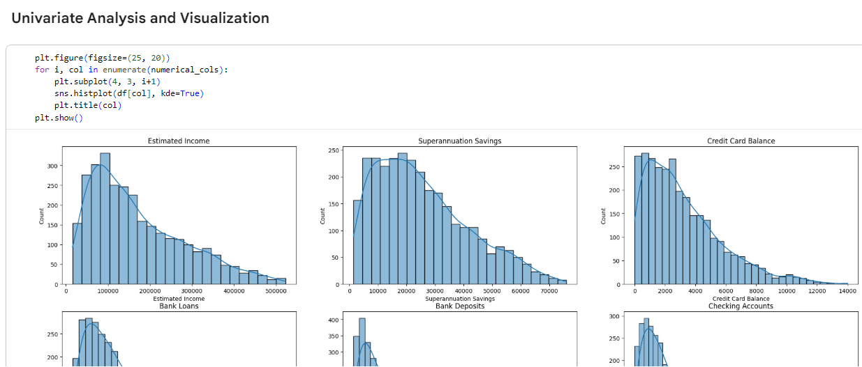

End-To-End Banking Analytics Workflow
MS Excel
Data Collection • Raw Banking Dataset • CSV/Excel
My SQL
Data Storage • Structured Tables • Querying
Python
EDA • Cleaning • Visualization
Pandas • Matplotlib • Seaborn
DAX • KPI • Modeling
Power Query • Interactive Visuals • Dashboard Preparation
Power BI
Dashboard
Interactive Visuals • Filters • Slicers • KPI Cards
Loan & Deposit Analysis • Customer Segmentation
Banking KPI Analysis • Risk Insights • Recommendations
Trend Analysis • Decision-Making Support
Insights

Slide 5

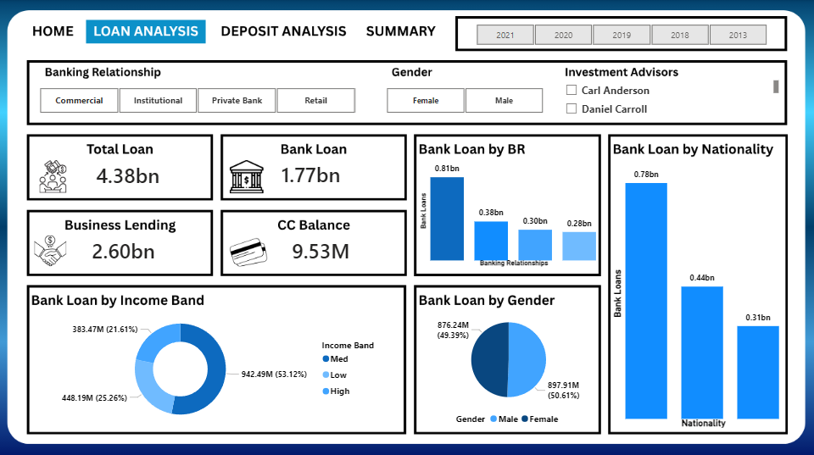
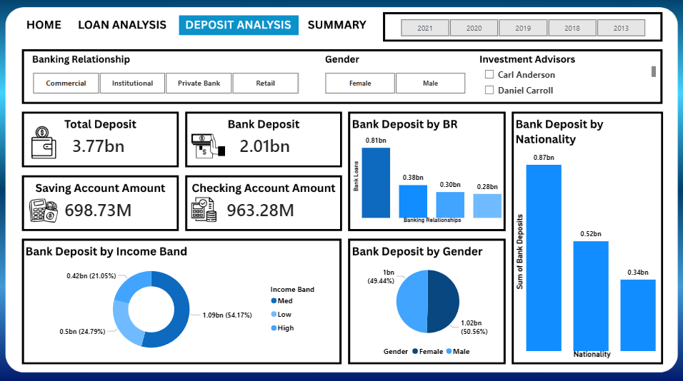
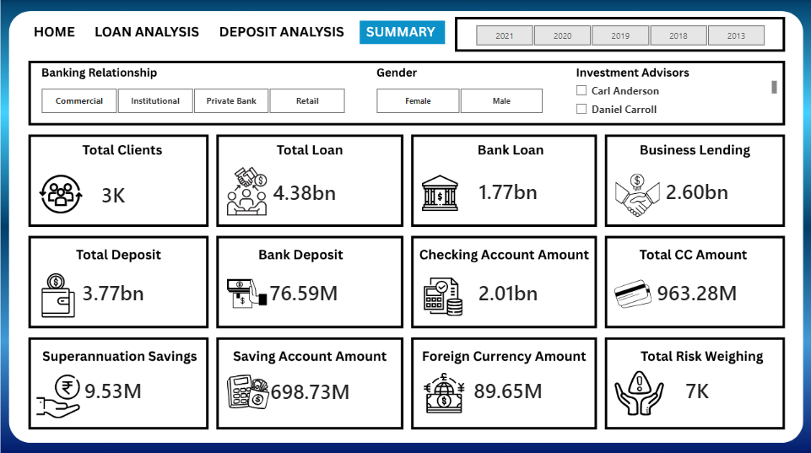
Dashboard Overview & KPIs
Dashboard Overview
The interactive Power BI dashboard provides a centralized view of banking operations, customer financial behavior, loans, deposits, and key banking performance indicators through dynamic visualizations and filtering capabilities.
Key KPIs Monitored
👥 Total Clients 💰 Total Loans 🏦 Total Deposits 📈 Business Lending 💳 Credit Card Balance
Interactive Features
🎛 Dynamic Filters & Slicers 📈 Real-Time KPI Monitoring 🔄 Interactive Navigation 📊 Cross-Filtering Visualizations 📅 Year-wise Analysis 🏦 Banking Relationship Analysis
Interactive Banking Analytics Dashboard developed using Power BI

Slide 6
Key Insights & Conclusion
Key Business Insights
📈 Commercial banking customers contribute the highest deposit amounts.
👥 Medium-income customers represent a major portion of banking activity.
💰 Business lending contributes significantly to the total loan portfolio.
🏦 Private banking customers show higher engagement and account activity.
📊 Interactive KPI monitoring helps identify customer financial patterns and banking performance trends.
Conclusion
The Banking Risk & Customer Analytics Dashboard successfully transformed raw banking data into meaningful business insights using interactive visualizations and KPI-driven reporting.
This project enhanced understanding of:
Banking analytics
Business intelligence
Dashboard storytelling
KPI reporting
Interactive Power BI development
Technologies Used

Slide 7
THANK YOU

